Slide 1
End To End Churn Analysis Project

Slide 2
Agenda
ETL process
Challenges
SQL
Advanced data analytics
Advance visualization
Storytelling and insight
Executive summary dashboard
My recommendation

Slide 3
Introduction to Churn Analysis
In today’s competitive business environment, retaining customers is crucial for long-term success. Churn analysis is a key technique used to understand and reduce this customer attrition. It involves examining customer data to identify patterns and reasons behind customer departures. By using advanced data analytics and machine learning, businesses can predict which customers are at risk of leaving and understand the factors driving their decisions. This knowledge allows companies to take proactive steps to improve customer satisfaction and loyalty.
Although this project focuses on churn analysis for a telecom firm, the techniques and insights are applicable across various industries. From retail and finance to healthcare and beyond, any business that values customer retention can benefit from churn analysis. We will explore the methods, tools, and best practices for reducing churn and improving customer loyalty, transforming data into actionable insights for sustained success.

Slide 4
Project Target

Slide 5
Create an entire ETL process in a database & a Power BI dashboard to utilize the Customer Data and achieve below goals:
Visualize & Analyse Customer Data at below levels
Demographic
Geographic
Payment & Account Info
Services
Study Churner Profile & Identify Areas for Implementing Marketing Campaigns
Metrics Required
Total Customers
Total Churn & Churn Rate
New Joiners

Slide 6
ETL process (extract, transform, and load)

Slide 7
ETL Process in SQL Server
So the first step in churn analysis is to load the data from our source file. For this purpose I will be using Microsoft SQL server because it is a widely used solution across the industry and also because a full-fledged Database System is better at handling recurring data loads and maintaining data integrity compared to an excel file.
Download SSMS
In order for us to run our sql queries Microsoft provides us with GUI interface which is known as SQL Server Management Studio. You can download the latest version from the link provided below.
https://learn.microsoft.com/en-us/sql/ssms/download-sql-server-management-studio-ssms?view=sql-server-ver16

Slide 8

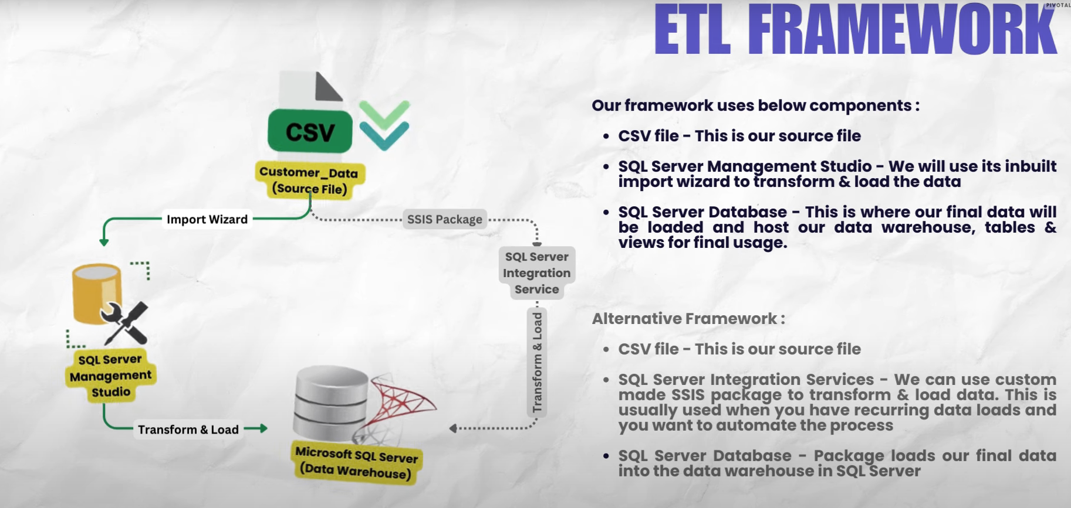
market overview

Slide 9
Challenges

Slide 10
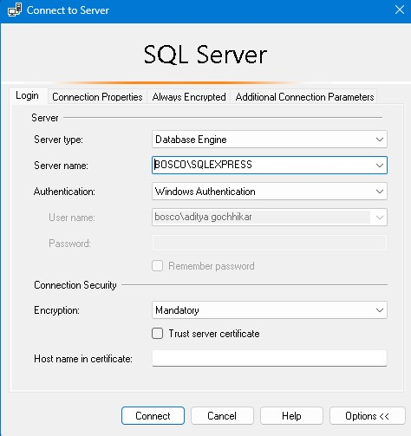
After I download my SQL management studio (2019) I will face create a local server in my device so to tackle this problem follow this You Tube video
FIX: SSMS Server Name Not Showing video link
After resolve all of the challenge here I find my server name
Allow this

Slide 11
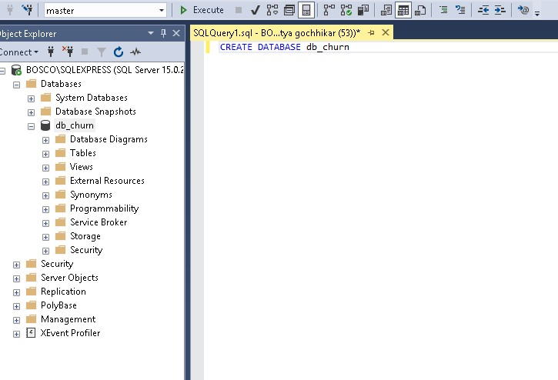
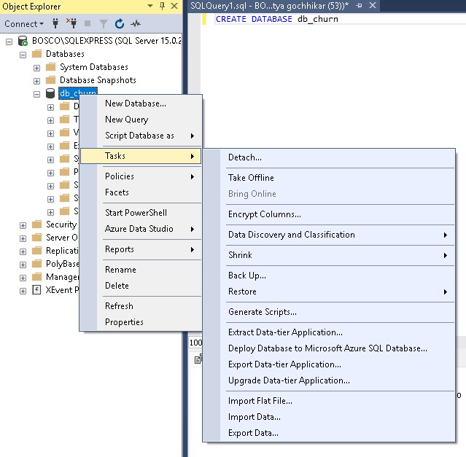
Creating Database
After installation, I will land on the following screen. Then to copy paste the server name somewhere because we will need this at a later stage. Also enable the checkbox which says “Trust Server Certificate” and then click on Connect Once connected, click on NEW QUERY button at the top ribbon and then write below query. This will create a new Database named db_Churn

Slide 12
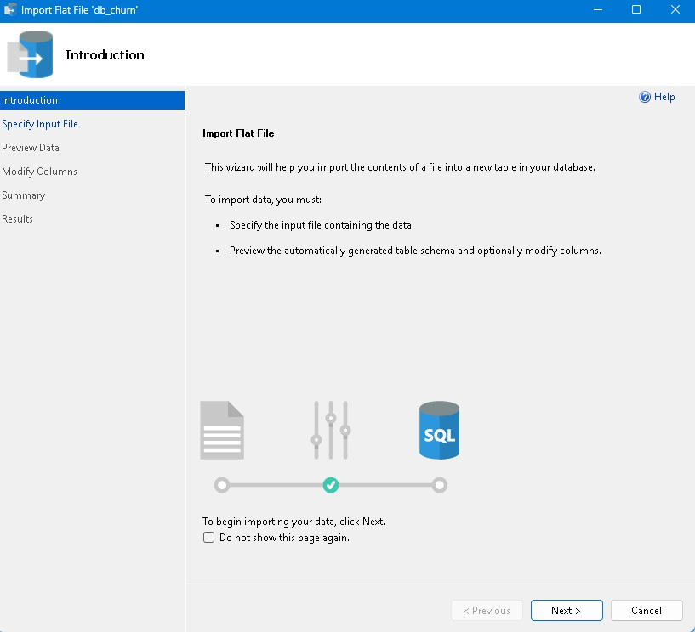
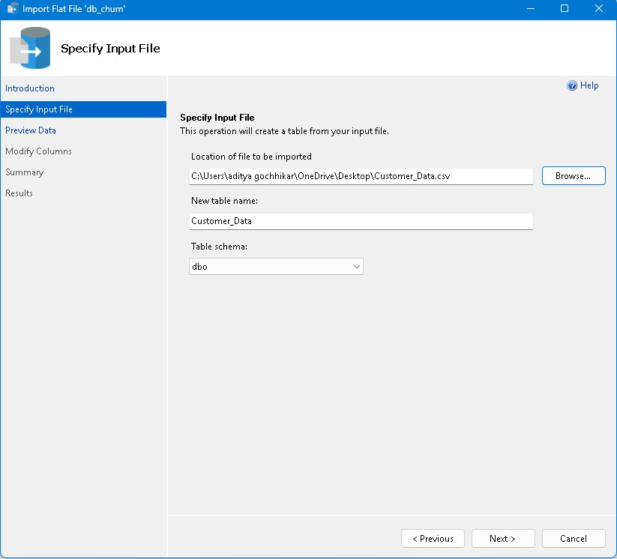
After clicking next then I browse data set in your system

Slide 13
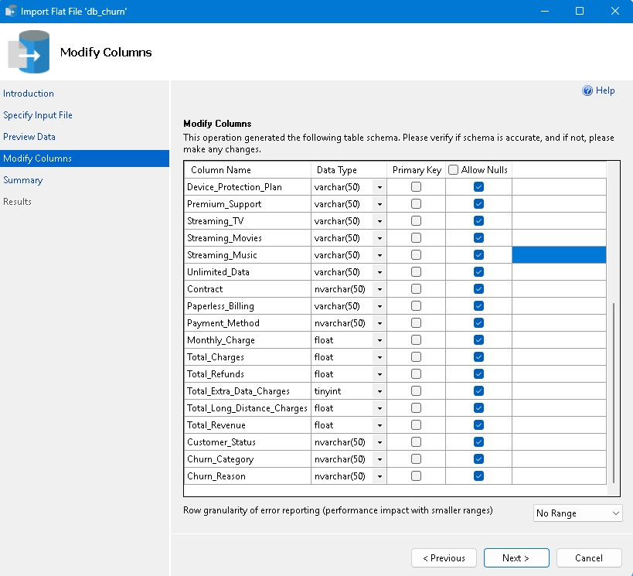
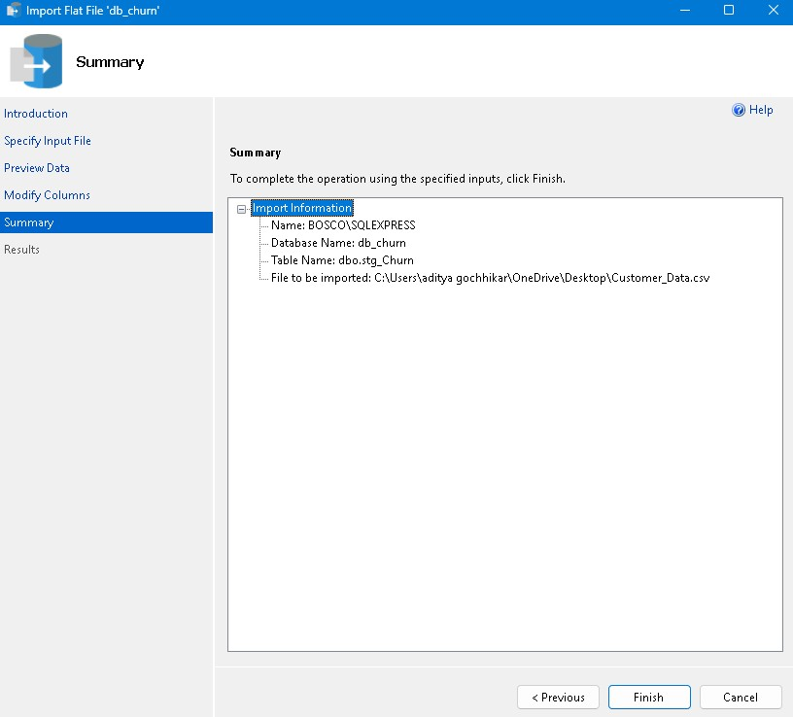
Remember to add customerId as primary key and allow nulls for all remaining columns. This is done to avoid any errors while data load. Also make sure to change the datatype where it say Bit to Varchar(50). I doing this because while using import wizard I faced issues with the BIT data type, however Varchar(50) works fine.

Slide 14
SQL

Slide 15
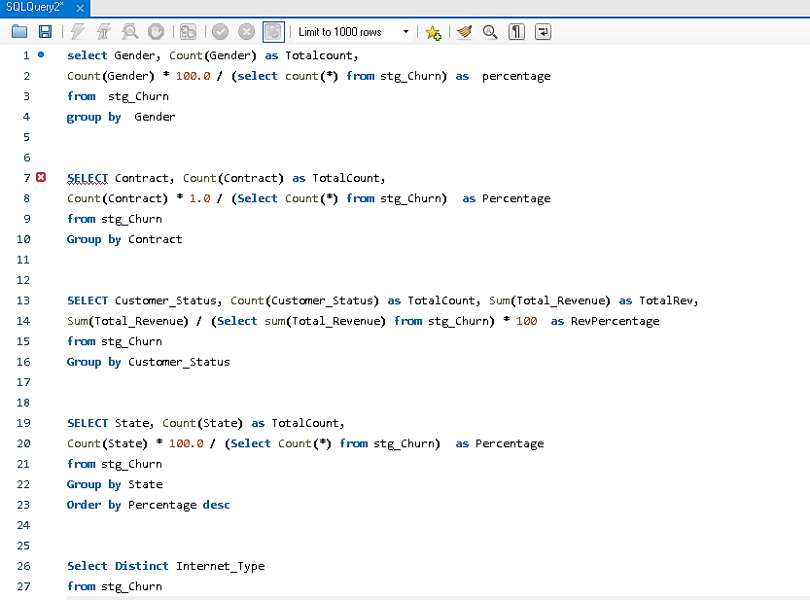
Data Exploration –
Check Distinct Values

Slide 16
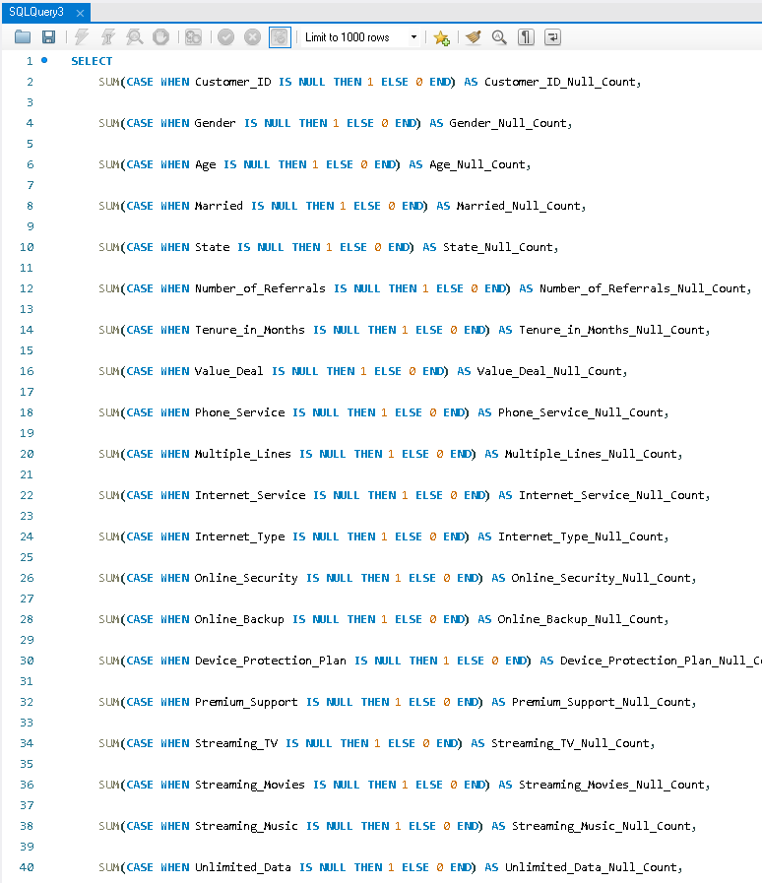
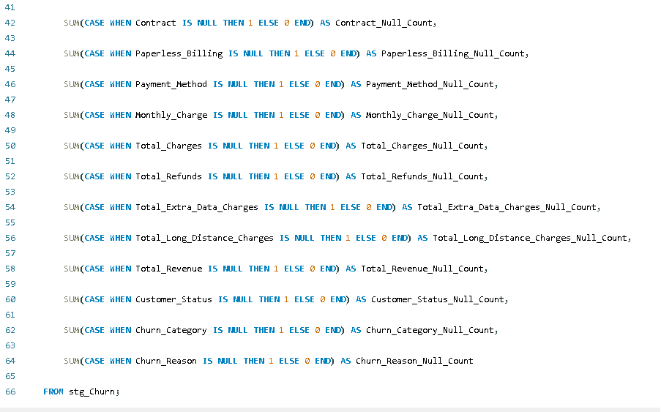
Data Exploration –
Check Nulls

Slide 17
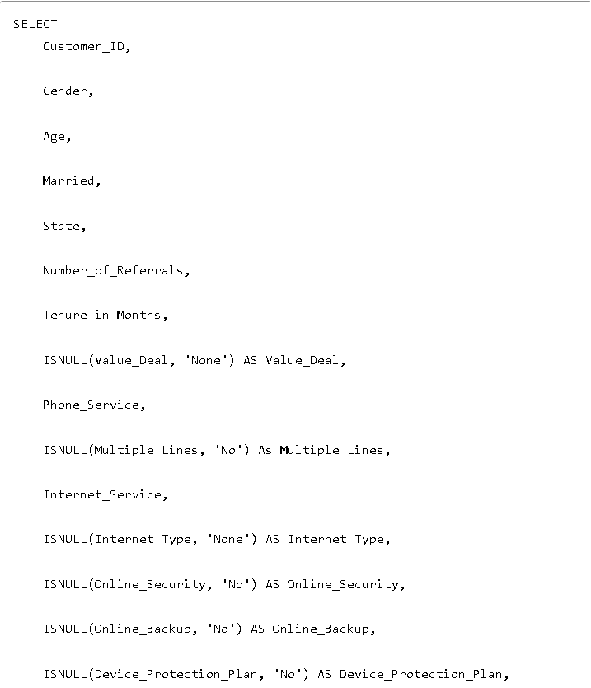
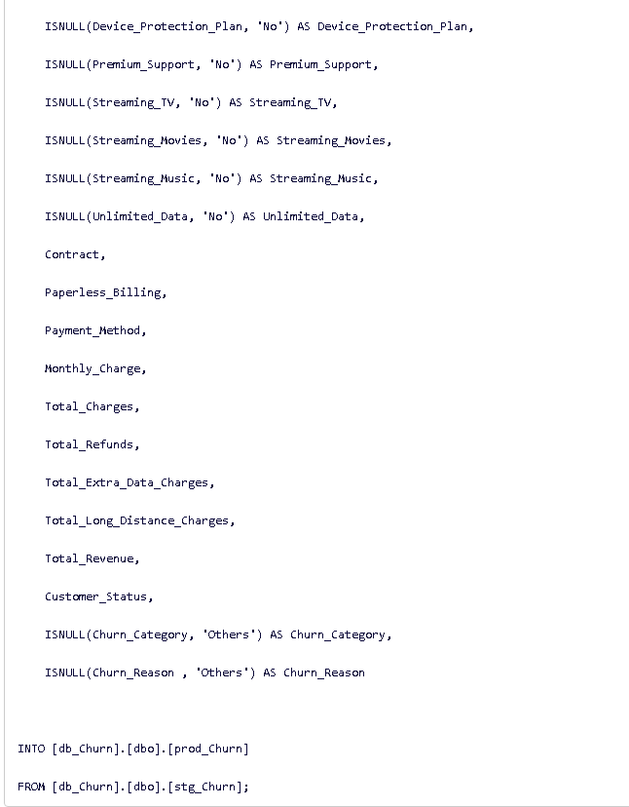
Remove null and insert
the new data into Prod table

Slide 18
Power BI Transform

Slide 19
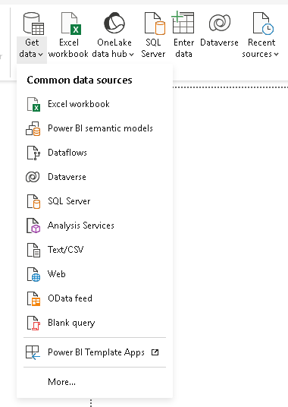
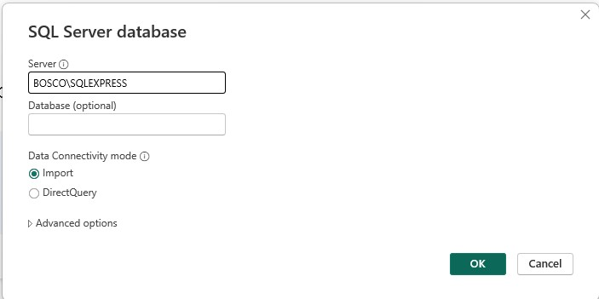
Connect my data into power BI

Slide 20
Add a new column in prod_Churn
DAX
1. Churn Status = if [Customer_Status] = “Churned” then 1 else 0
2. Change Churn Status data type to numbers
3. Monthly Charge Range = if [Monthly_Charge] < 20 then “< 20” else if [Monthly_Charge] < 50 then “20-50” else if [Monthly_Charge] < 100 then “50-100” else “> 100”

Slide 21
Create a New Table Reference for mapping_AgeGrp
1. Keep only Age column and remove duplicates
2. Age Group = if [Age] < 20 then “< 20” else if [Age] < 36 then “20 – 35” else if [Age] < 51 then “36 – 50” else “> 50”
3. AgeGrpSorting = if [Age Group] = “< 20” then 1 else if [Age Group] = “20 – 35” then 2 else if [Age Group] = “36 – 50” then 3 else 4
4. Change data type of AgeGrpSorting to Numbers
DAX

Slide 22
Create a new table reference for mapping_TenureGrp
1 Keep only Tenure_in_Months and remove duplicates
2. Tenure Group = if [Tenure_in_Months] < 6 then “< 6 Months” else if [Tenure_in_Months] < 12 then “6-12 Months” else if [Tenure_in_Months] < 18 then “12-18 Months” else if [Tenure_in_Months] < 24 then “18-24 Months” else “>= 24 Months”
3.TenureGrpSorting = if [Tenure_in_Months] = “< 6 Months” then 1 else if [Tenure_in_Months] = “6-12 Months” then 2 else if [Tenure_in_Months] = “12-18 Months” then 3 else if [Tenure_in_Months] = “18-24 Months ” then 4 else 5
4.Change data type of TenureGrpSorting to Numbers
DAX

Slide 23
Create a new table reference for prod_Services
Unpivot services columns
. Rename Column – Attribute >> Services & Value >> Status

Slide 24

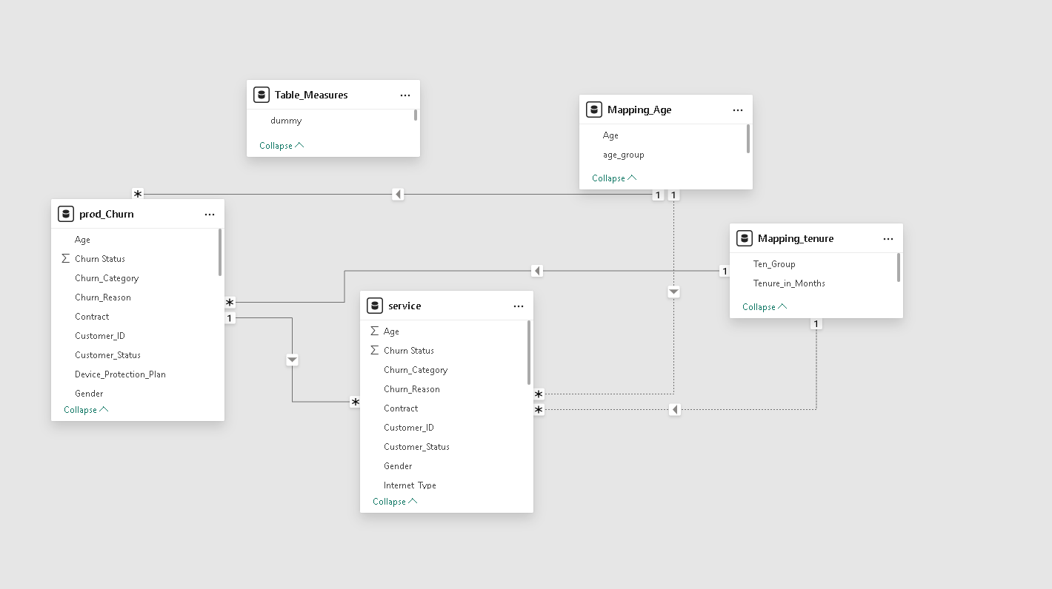
market comparison
Stands out in market
Innovative features
Provides unique solution
Edge over competitors
User-focused design
Prioritizes user experience

Slide 25
Power BI Visualization
Summary Page
1. Top Card
a. Total Customers
b. New Joiners
c. Total Churn
d. Churn Rate%
2. Demographic
a. Gender – Churn Rate
b. Age Group – Total Customer & Churn Rate
4. Geographic
a. Top 5 State – Churn Rate
3. Account Info
a. Payment Method – Churn Rate
b. Contract – Churn Rate
c. Tenure Group – Total Customer & Churn Rate
5. Churn Distribution
a. Churn Category – Total Churn
b. Tooltip : Churn Reason – Total Churn
6. Service Used
a. Internet Type – Churn Rate
b. prod_Service >> Services – Status – % RT Sum of Churn Status
Churn Reason Page (Tooltip)
1. Churn Reason – Total Churn

Slide 26
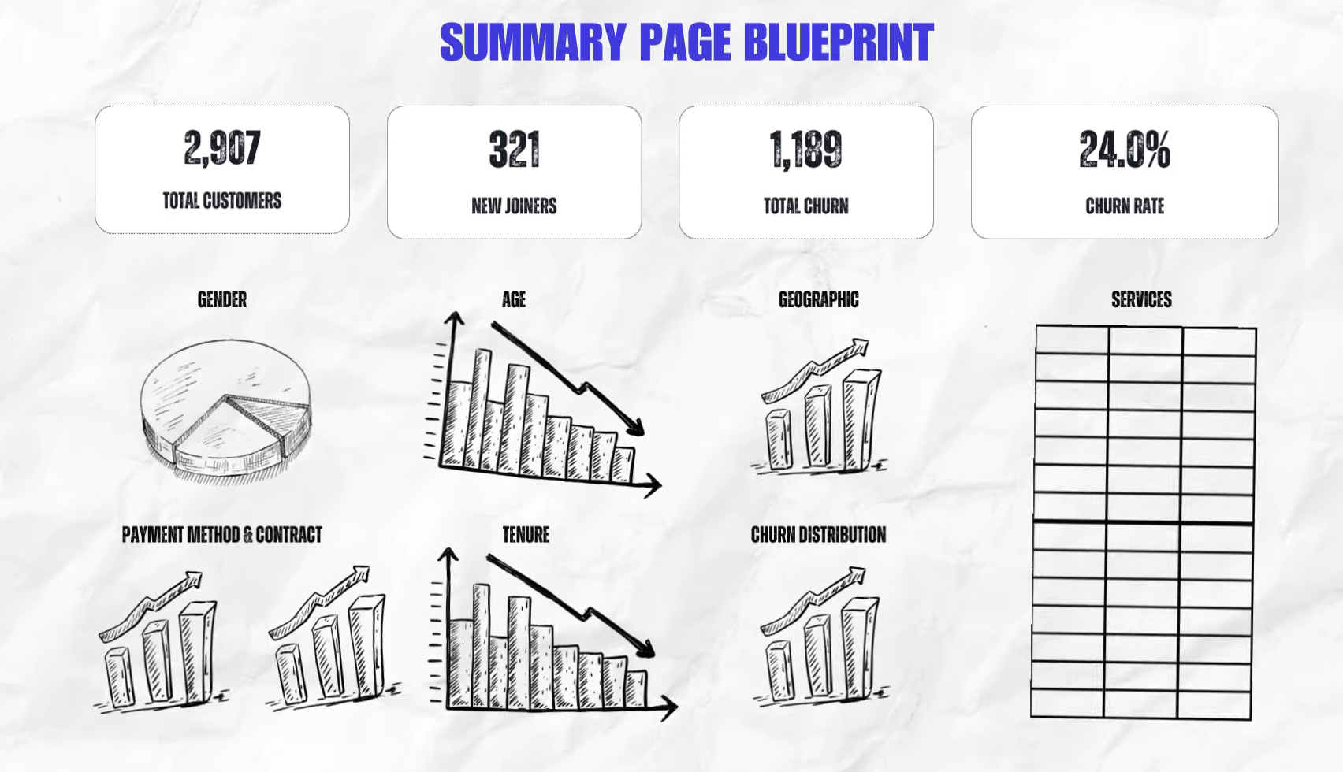
product benefits
Increased productivity
Seamless integration
Enhanced user experience
Scalability for future growth
User-friendly learning

Slide 27
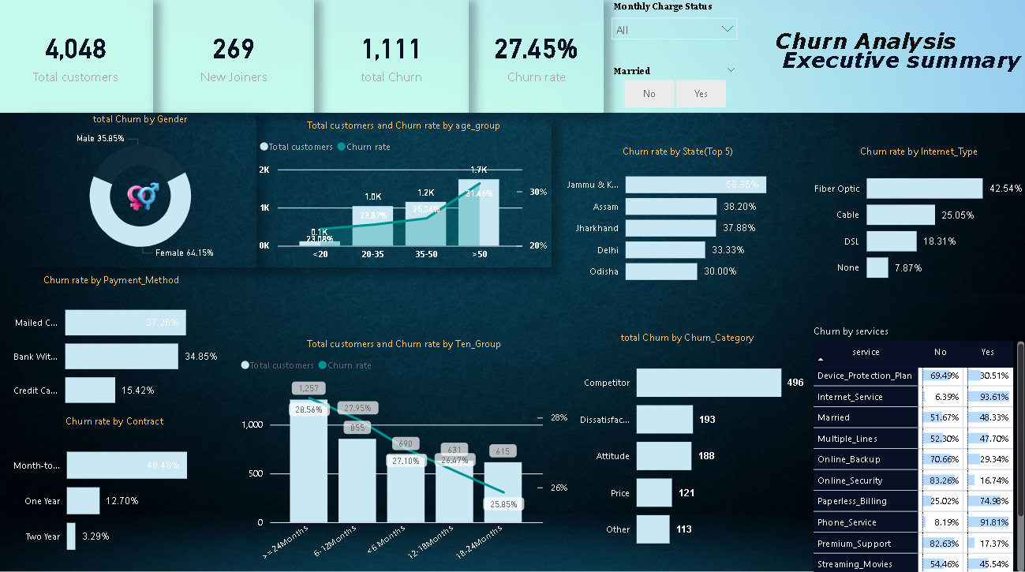
market comparison
DEMOGRAPHIC
Milestone | Quarter
Product launch | Q1
10,000 user milestone | Q2
Strategic partnership | Q3
Campaign launch | Q4
GEOGRAPHIC
SERVICES USED
Product launch
Successful introduction of our product to market
10,000 user milestone
Substantial user base, indicating growing demand
Strategic partnership
Expanding market presence and capabilities
ACCOUNT INFO
CHURN DISTRIBUTION

Slide 28
thank you
Aditya gochhikar

